Slide 1
WELCOME TO THE MURDER OF GEORGE FLOYD AND THE HISTORY OF POLICING
Welcome! Welcome! Welcome!
We will get started at 2:05pm.
Please:
1. Rename yourself to include your pronouns.
2. Read/Listen to any part of section 1 “Where We’ve Been”

Slide 2
Agenda
2:00pm Welcome
2:05pm Overview of Agenda
2:10pm Check-In
2:20pm Origins of Policing Lecture
2:30pm Group-Work
2:45pm Share Out
2:57pm Exit Ticket
Class 2: Where We’ve Been (Historical Context)
Students read, annotate and summarize part of the “Where We’ve Been” section of the MPD150 report. They work in small groups to identify central themes, cite evidence, and reflect on their reactions and connections to the text. Students learn about the origins of policing and further their discussion of what the function of history is.
Compelling Questions: How does racism manifest in social institutions? How does knowing a history help us understand institutions/current events? What role has the police department played in the Minneapolis community?

Slide 3
Check-In
Having read some of the report, how are you feeling? What was your immediate reactions? Anything you weren’t expecting? Do you like it?
Kindle reader app or? – annotating (will explain how I go about doing this)
Community Agreements
I need a lot of feedback, so drop a: <3 or :) or !!! or ??
Speak your truth – I statements
RESPECT everyone’s experiences, feelings and opinions
Be open and lean in
Don’t speak over people – one mic
Black lives over white feelings
Be an ally

Slide 4
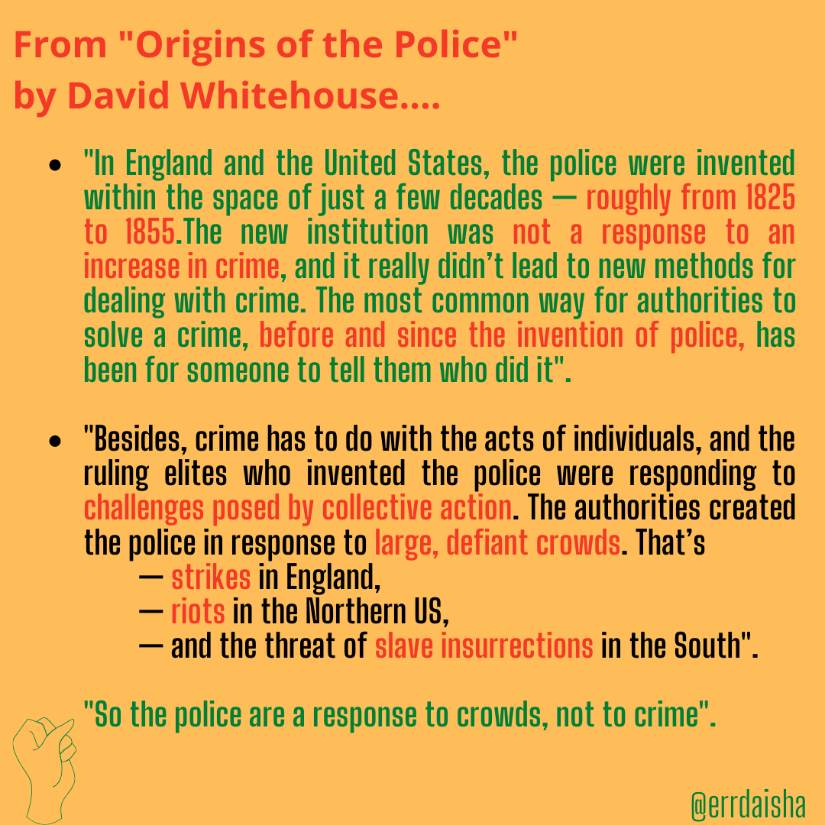
Origins of Policing Lecture
A note on the beginning of policing in England:
“﻿In 1829, growing levels of property crime caused by urbanization and the creation of urban poverty led to the creation of a police force in London—the Metropolitan Police Department”…
Policing began in England to maintain their rule and control rebellious communities in Ireland
“rooted in colonialism and protection of property”

Slide 5
Timeline from the sunrise movement DTP crash course
”These patrols (and their Northern equivalents, town watches) were empowered to enforce curfews against Black and Native folks, search and confiscate their property, and brutalize them, with or without cause.2 These groups were gradually granted additional powers and jurisdiction, eventually evolving directly into modern police departments. One example of this can be seen in Charleston, South Carolina, where a town watch created in 1671 for the explicit purpose of keeping Native and Black people in line eventually turned into the city’s first police department”.

Slide 6
Critical Resistance Timeline

Slide 7
Group Work
Answer questions together/discuss answers
Identify central themes (racism, policing, abolition, safety, justice, community)
Cite evidence (answer to questions come from text)
Reflect on connections to the text

Slide 8
Share out
Essential themes and evidence from your part.

Slide 9
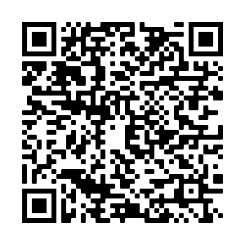
Exit Ticket
MPD150 REPORT: PART 2 “Where We’re At”
Read/listen to part 2 for 10 minutes and skim the rest
Read/listen to part 2 for 15 minutes and skim the rest
Read/Listen to part 2 for 30 minutes
HOMEWORK
Notes:
https://docs.google.com/forms/d/e/1FAIpQLSd8nWCXd0Yuzg1Wn0boH86HKdr7CaDy3nt64Sbj42KCNQrFfQ/viewform?usp=sf_link

